Slide 1
NBAC TSC Slides 12 December 2024 Meeting

Slide 2
12 DEC 2024 NBAC TSC Agenda
1:00 NBAC Co-Chair Opening Remarks – Mr. Kamran Atri & Thomas Krul
Next PGB Meeting 30 Jan 2025, 2-4 PM
Join PGB Mailing List – email niemopen-pgb+subscribe@lists.oasis-open-projects.org
Attend 30 Jan PGB meeting 2-4 PM (slide 3)
Current PGB Members (slides 4 & 5)
2025 NBAC Monthly Meeting calendar posted – last Thursday of every month 1-2 PM Eastern Time
https://lists.oasis-open-projects.org/g/niemopen-nbactsc/calendar
1:10 NIEM Management Office (NMO) Update – Ms. Katherine Escobar
NIEMOpen Excellence Awards – Shunda Louis
https://niemopen.org/excellence-awards-2025/
1:20 NTAC Update – Dr. Scott Renner
NDR 6.0 – Dr. Scott Renner
Training – Tom Carlson
Model Update v6.0 & API 2.0 - Christina Medlin not available but place her api slides in backup
1:30 Communications & Outreach NMO Sub-Committee update – Paul Wormeli
1:35 Community Updates - all
1:40 Questions/Final Remarks
Slides available at 12 December Minutes folder, NBAC Admin Repo
https://github.com/niemopen/nbac-admin/tree/main/nbac-meeting-minutes

Slide 3
Venue
Microsoft Teams 30 January 2025 PGB Meeting
PGB Meeting
30 January 2025
Virtual Meeting 2-4 PM EST
Virtual: MS TEAMS
Microsoft Teams NIEMOpen PGB Meeting Need help?
Join the meeting now
Meeting ID: 993 967 584 930
Passcode: JTiu7a
Dial in by phone
+1 410-874-6749,,296683050# United States, Odenton
Find a local number
Phone conference ID: 296 683 050#
For organizers: Meeting options | Reset dial-in PIN
PGB Minutes & documents: https://github.com/niemopen/oasis-open-project/tree/main/pgb-meeting-minutes

Slide 4

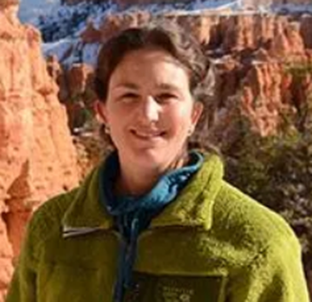




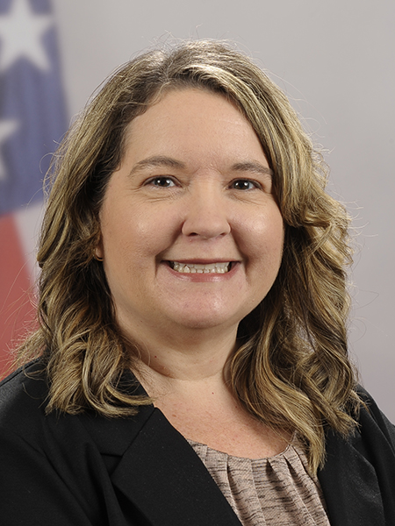
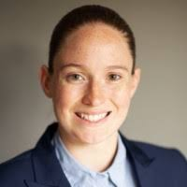


PGB APPOINTED VOTING MEMBERS
Ms. Katherine Escobar
PGB Chair
Deputy Division Chief, Data and Standards Division at Joint Staff J6 and NIEM Managing Director
Ms. Christina Bapst-Stump
Science and Technology Directorate, US Department of Homeland Security
Mr. Gary Egner
Director Business Development, Equivant
Mr. John Wandelt
Principal Research Scientist, Georgia Tech Research Institute
Ms. Maria Cardiellos
Executive Director
Integrated Justice Information Systems Institute
Mr. Payton Lamb
Data Engineer
Commonwealth of Virginia
Office of the secretary of Administration
Office of Data Governance and Analytics
Ms. April Mitchell
FBI It Specialist and Technical Lead of Data Standards in the Criminal Justice Information Services (CJIS) Division
Ms. Erin Partin
Data Scientist, Office of the Principal Deputy Director, National Institute of Justice (NIJ)
Ms. Erica Smith
Data Scientist, Unit Chief – Law Enforcement Incident-Based Statistics Unit, Bureau of Justice Statistics(BJS)
Mr. Tom Welch Director of Information Technology
OHIO HIDTA – Including Northern KY & Western PA
Notes:
Open Project Rules - OASIS Open (oasis-open.org)
5.1 Overall guidance for the Project is provided by its Project Governing Board (or PGB). The PGB is composed of one voting member from each Project Sponsor who elects to appoint a PGB member, and (a) if the PGB has one or more Technical Steering Committees, one voting expert representative from each TSC, elected or appointed by that TSC, or (b) otherwise, the PGB may appoint at least one and no more than two voting expert representatives from its community of contributors. The PGB may create additional non-voting PGB member seats for expert representatives to be elected by the TSC or appointed by the PGB. The PGB membership of all such members of any type is conditioned on satisfaction of the CLA requirement of Section 5.2. Voting status on the PGB may be affected by the provisions of Section 5.7.

Slide 5



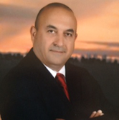

PGB EXPERT VOTING MEMBERS &
NON-VOTING MEMBERS
PGB EXPERT VOTING MEMBERS
Technical Steering Committees
PGB EXPERT NON-VOTING MEMBERS
Technical Steering Committees
Mr. Thomas Krul
Co-Chair, NIEM Business Architecture Committee TSC
Mr. Brad Bolliger
Co-Chair, NIEM Technical Architecture Committee TSC
Mr. Kamran Atri
Co-Chair, NIEM Business Architecture Committee TSC
Ms. Beth Smalley
Co-Chair, NIEM Management Office TSC
Dr. Scott Renner
Co-Chair, NIEM Technical Architecture Committee TSC
Notes:
Open Project Rules - OASIS Open (oasis-open.org)
5.1 Overall guidance for the Project is provided by its Project Governing Board (or PGB). The PGB is composed of one voting member from each Project Sponsor who elects to appoint a PGB member, and (a) if the PGB has one or more Technical Steering Committees, one voting expert representative from each TSC, elected or appointed by that TSC, or (b) otherwise, the PGB may appoint at least one and no more than two voting expert representatives from its community of contributors. The PGB may create additional non-voting PGB member seats for expert representatives to be elected by the TSC or appointed by the PGB. The PGB membership of all such members of any type is conditioned on satisfaction of the CLA requirement of Section 5.2. Voting status on the PGB may be affected by the provisions of Section 5.7.

Slide 6
NDR 6.0 Revision
Update – Dr. Scott Renner
A major rewrite of NDR 5.0
A new abstract UML metamodel defining the information content of a NIEM model
Two concrete model formats: XSD and CMF
Two supported message formats: XML and JSON
Simplified conformance rules for message schemas
Changes to augmentation and metadata
More explanation, (slightly) less technical detail
Working draft (PSD01) available:
https://github.com/niemopen/niem-naming-design-rules/blob/dev/ndr6src.md

Slide 7
NIEMOpen 6.0 Training
Plans:
Updated to NIEM 6.0
Architecture
Methodologies
Addition of CMF and JSON material
Modularized:
Shorter videos, linked together to provide multiple tracks
Easily consume training in whichever format, XML, JSON, or even CMF
Tool demos as separate standalone pieces or inline with training
Current Tasks:
Conversion of examples to NIEM 6 in XML, CMF, and JSON
Conversion of Crash Driver sample IEPD to NIEM 6 in XML, CMF, and JSON
Descriptions/diagrams of high level architecture changes

Slide 8
Niem Model 6.0 Update
NIEM Model 6.0 PS01 published Dec 2023
16 domains
19,000 properties
10,000 types
110,000 code values
NIEM Model 6.0 PS02 pending
Minor adjustments to the structures namespace to support NDR updates
Update internal draft version numbers
Bundle submission to PGB with NDR 6.0 PSD01 in December

Slide 9








Resources
Follow Us On Twitter
https://twitter.com/NIEMconnects?ref_src=twsrc%5Etfw
Katherine Escobar, katherine.b.escobar.civ@mail.mil, 757-203-8631
Git Repos
NIEMOpen: https://github.com/niemopen/
NTAC TSC
https://github.com/niemopen/ntac-admin
NBAC TSC
https://github.com/niemopen/nbac-admin
NMO TSC
https://github.com/niemopen/nmo-admin
NIEMOpen Slack Channel: https://niemopen.slack.com/
Mailing Lists
NIEMOpen: https://lists.oasis-open-projects.org/g/niemopen
PGB: https://lists.oasis-open-projects.org/g/niemopen-pgb
NTAC TSC: https://lists.oasis-open-projects.org/g/niemopen-ntactsc
NBAC TSC: https://lists.oasis-open-projects.org/g/niemopen-nbactsc
NMO TSC: https://lists.oasis-open-projects.org/g/niemopen-nmotsc
https://www.niem.gov/
https://niemopen.org/
https://www.linkedin.com/groups/1903175/profile
https://www.youtube.com/channel/UCg9qV22PXLBjG41hc-EwVrQ
IEPD/MEP REPO
MEP TOOL
CMF TOOL

Slide 10
backup

Slide 11
Niem API 2.0 and NIEM Toolbox – 1
Transition legacy NIEM tools into updated open source products. Move key functionality out of tools into the API for reusability.
Feature | NIEM API | NIEM Toolbox
(Background) | Java / Spring Boot and PostgreSQL database Hosted via GTRI | Nuxt (JS) SPA Hosted via GitHub Pages (free)
Transforms | Transform models into other formats Inputs – CMF or NIEM XSD Outputs – CMF, XSD, JSON Schema, or OWL Leverages the CMF tool | Form to upload file and set options API request Download results
Validation | XSD – Validate and check NDR conformance XML – Validate against provided schema CMF – Validate against schema (NTAC) IEPD catalog – Validate against schema (NTAC) XML catalog – Validate against schema (OASIS) | Form to upload file and set options API request Download and view results
Migration | Migrate from one supported model version to a more recent version Can iterate over multiple versions in one call Accepts input and generates results as CMF | Form to upload file and set options API request Download and view results
Done
In progress

Slide 12
Niem API 2.0 and NIEM Toolbox – 2
Transition legacy NIEM tools into updated open source products. Move key functionality out of tools into the API for reusability.
Feature | NIEM API | NIEM Toolbox
Model data | Return information about models, versions, namespaces, properties, classes, datatypes, and facets Supports NIEM and published community models NIEM data 1.0 – 5.2 currently available | Browse model data View information about components View information about curated list of common components
Search | Search properties, types, and codes Supports fuzzy searching, including tokens and substrings Filter results by namespace Component-specific search fields | Search models View results View information about components
Model management | Add, edit, and delete model content Model and component QA Load change request spreadsheets Generate release artifacts Generate model stats
Done
In progress

